Slide 1
PROJECTS
OF JSC “AGRARIAN CREDIT CORPORATION”
FOR IMPLEMENTATION BY INVESTORS

Slide 2
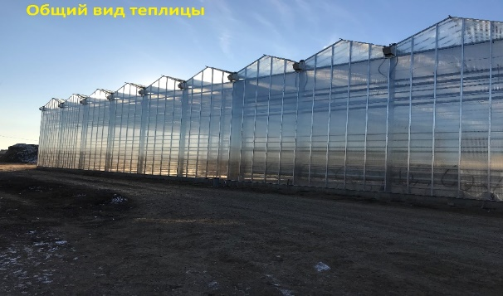
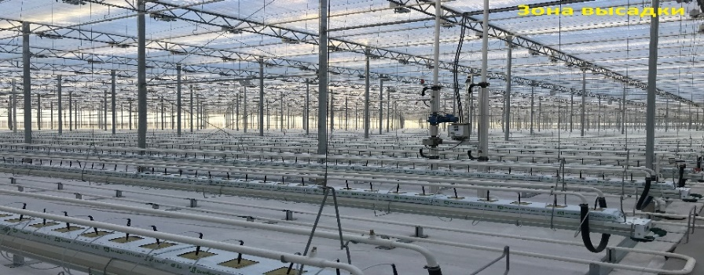
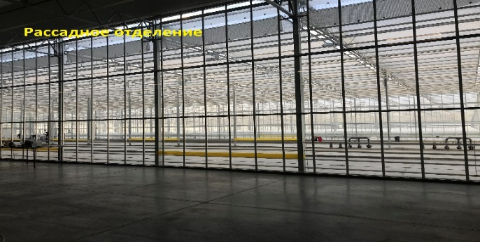
CONSTRUCTION OF A GREENHOUSE COMPLEX
GENERAL INFORMATION ABOUT THE PROJECT
Place of implementation | West Kazakhstan region, Uralsk, village of Zachagansk.
Commissioning | July 2020
Land Plot Provisioning | 5.6 ha for servicing the greenhouse complex, the total land plot area is 15.56 ha
Transport infrastructure | Availability of a network of highways and railways
Communications | All necessary communication is available
Annual production volume | Cucumbers, tomatoes 3,194 tons per year
2. PRELIMINARY CONDITIONS OF IMPLEMENTATION
Refinancing of STB debt, joining the founders of the LLP
The subject of the realizable property | Cost of sales, million tenge* | Term | Advance payment | Frequency of payments
Property - equipment of the greenhouse complex | 2,518.4 | Up to 6 years | At least 10% | At least 2 times a year
The building of the greenhouse complex located on the land plot | 3,296
Total | 5,814
*The cost may vary depending on the current assessment conducted by an independent appraisal company.
There is a need to attract investments.
3. OTHER INFORMATION: : All necessary communications are available. The client is currently selling cucumbers and tomatoes in Atyrau, Aktobe, Aktau, Ust-Kamenogorsk, Shymkent, Kostanay. It is possible to export products to the Russian Federation, due to the proximity to the border.

Slide 3
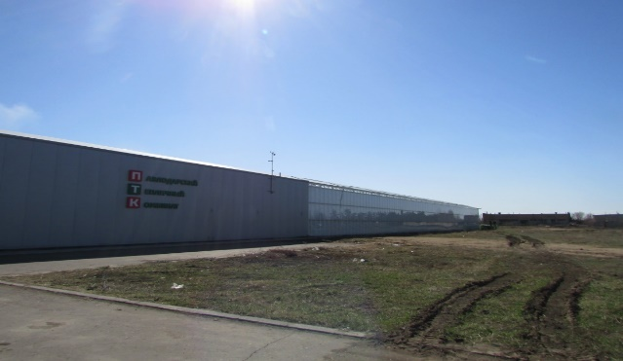
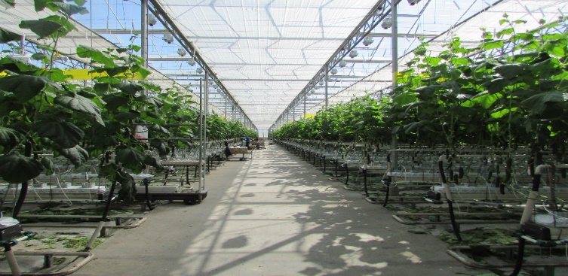
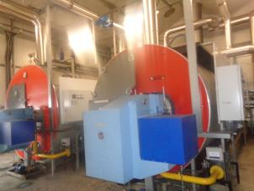
CONSTRUCTION OF A GREENHOUSE COMPLEX
GENERAL INFORMATION ABOUT THE PROJECT
Place of implementation | Pavlodar, Vostochnaya industrial zone, building 449.
Commissioning | April 2020
Land Plot Provisioning | 3 ha, the total land area is 8.2 ha
Transport infrastructure | Availability of a network of highways and railways
Communications | All necessary communication is available
Annual production volume | Cucumbers, tomatoes 3,500 tons per year
2. PRELIMINARY CONDITIONS OF IMPLEMENTATION
Refinancing of STB debt, joining the founders of the LLP
The subject of the realizable property | Implementation cost, million tenge | Term | Advance payment | Frequency of payments
Greenhouse complex | 1,908 | Up to 4 years | At least 10% | At least 2 times a year
Land plot with a checkpoint, total area – 1.9722 ha | 16
The land plot with a total area of 0.72 ha | 7
A set of equipment for a greenhouse complex | 550
Land plot (access road) with a total land area of 0.21 ha | 0.2
The system of electric illumination of plants | 549
Total | 3,032
*The cost may vary depending on the current assessment conducted by an independent appraisal company.
There is a need to attract investments.
3. OTHER INFORMATION: : All necessary communications are available. Sales of products within the country and the Russian Federation, due to the proximity of the location to the border.

